Slide 1

Robotics and Healthcare
Transforming Patient Care through Innovation

Slide 2
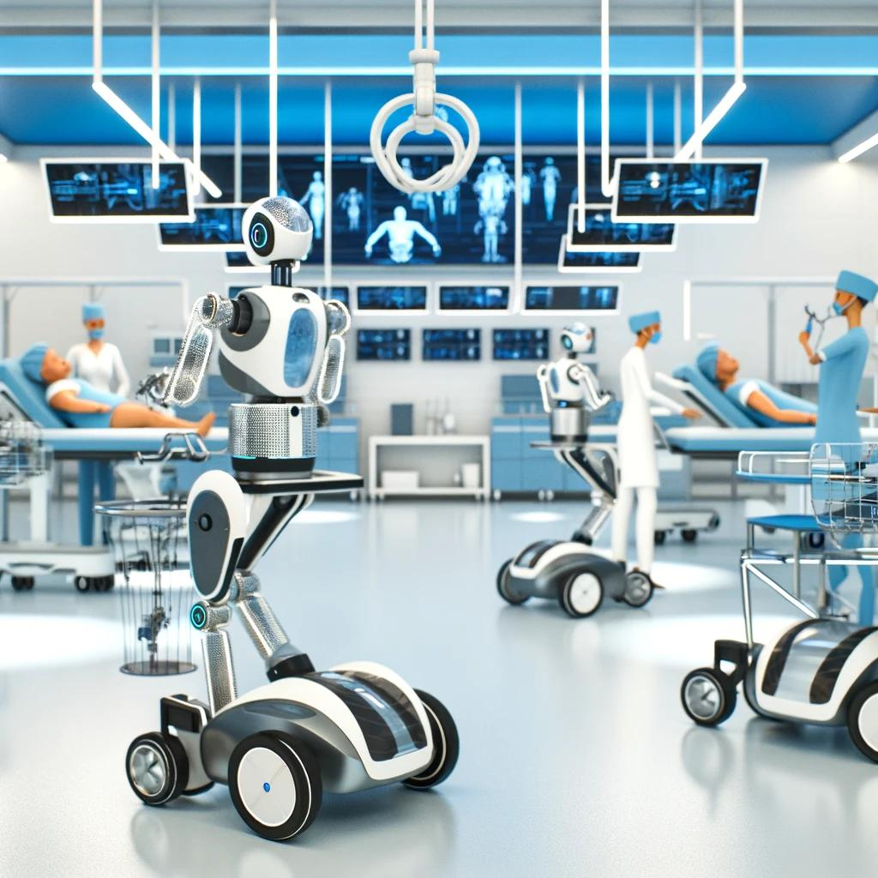

Slide 3

Introduction to Robotics in Healthcare
Importance of robotics in modern medicine
Key areas of impact: surgery, rehabilitation, patient care, and pharmacy automation
https://www.youtube.com/watch?v=2TcmjL6ZQzc

Slide 4
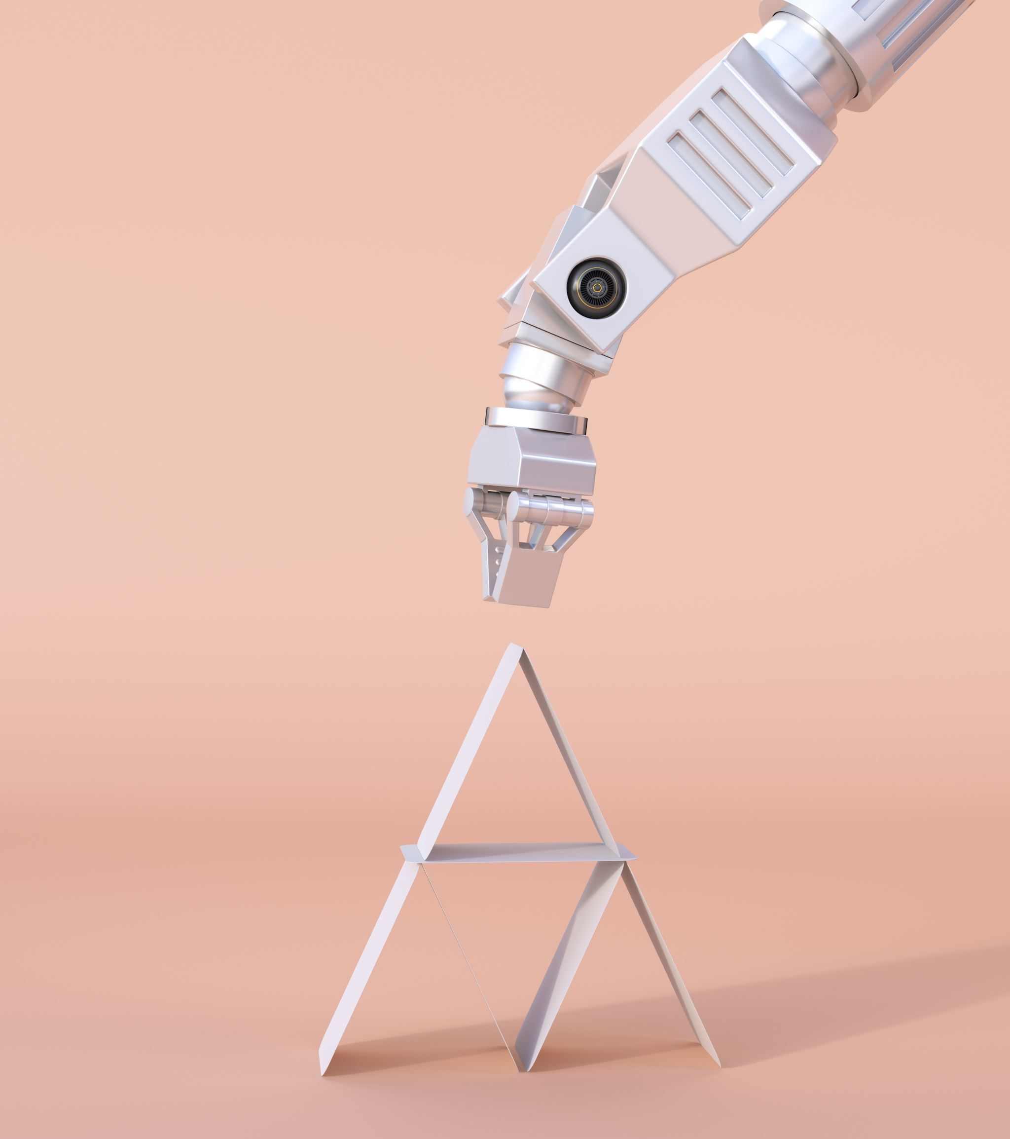
Types of Robots in Healthcare
Care Robots: Provide support in routine patient care, companionship, and monitoring
Disinfection Robots: Use UV light or chemical methods to sterilize hospital environments

Slide 5
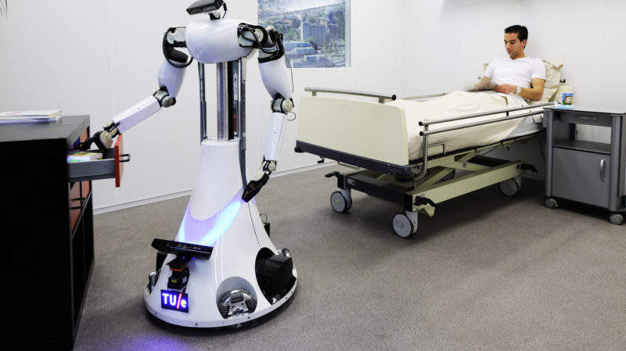

Slide 6
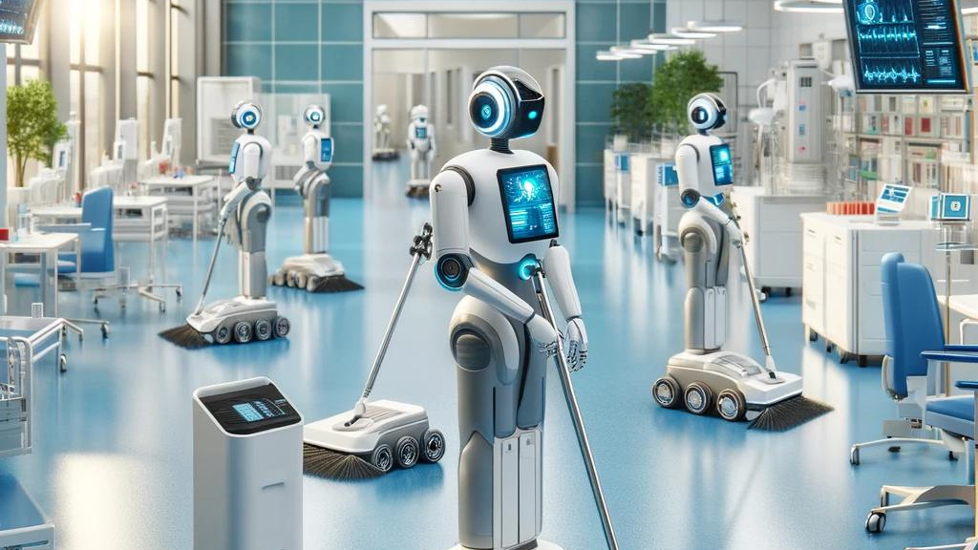

Slide 7
Types of Robots in Healthcare
Surgical Robots: Assist in performing precise surgeries, e.g., Da Vinci Surgical System
Rehabilitation Robots: Aid in patient recovery and mobility enhancement

Slide 8
Da Vinci Surgical System
The Da Vinci Surgical System represents a significant advance in minimally invasive surgery, aiming to improve clinical outcomes and redefine the experience of surgery for patients.

Slide 9
Robotic-Assisted Surgery: The system provides a set of robotic arms controlled by a surgeon from a console.
High Precision: It allows surgeons to perform complex procedures with increased precision, flexibility, and control compared to conventional techniques.
3D High-Definition Vision System: Offers surgeons a true-to-life 3D HD view inside the patient's body to enhance visibility.
Minimally Invasive: Designed to facilitate complex surgery using a minimally invasive approach, intended to reduce recovery time and potential complications.
Ergonomic Design: The surgeon's console is designed to provide comfort and to align the surgeon's eyes and hands with the instruments while providing a natural and intuitive experience.

Slide 10
Enhanced Dexterity: The system's instruments offer a greater range of motion than the human hand.
Scaled Movements: The system can scale the surgeon's hand movements, translating them into smaller, precise movements of tiny instruments inside the body.
Teaching Tool: It can be used as an educational platform, providing an immersive experience for surgical trainees.
Widely Adopted: Used worldwide in hundreds of thousands of surgeries, including cardiac, colorectal, gynecologic, head and neck, thoracic, and urologic procedures.
Continuous Innovation: The platform is continually evolving, incorporating the latest in robotics and computer technologies.

Slide 11
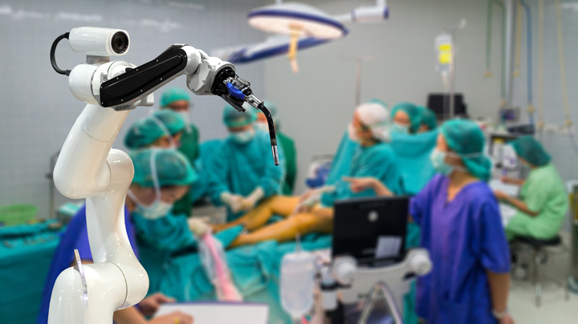

Slide 12
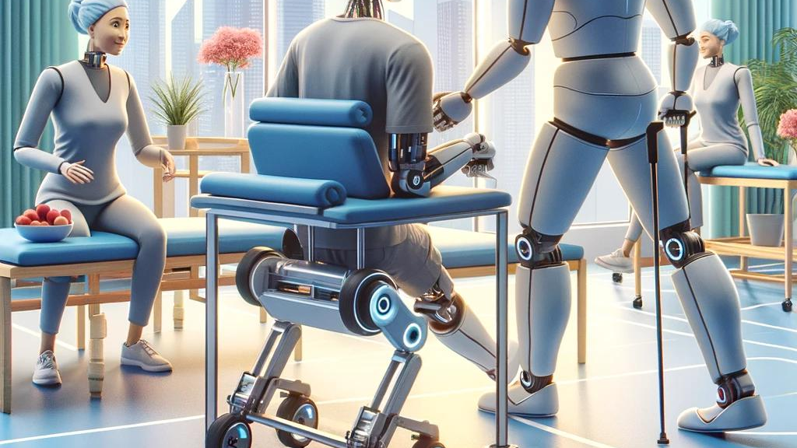

Slide 13
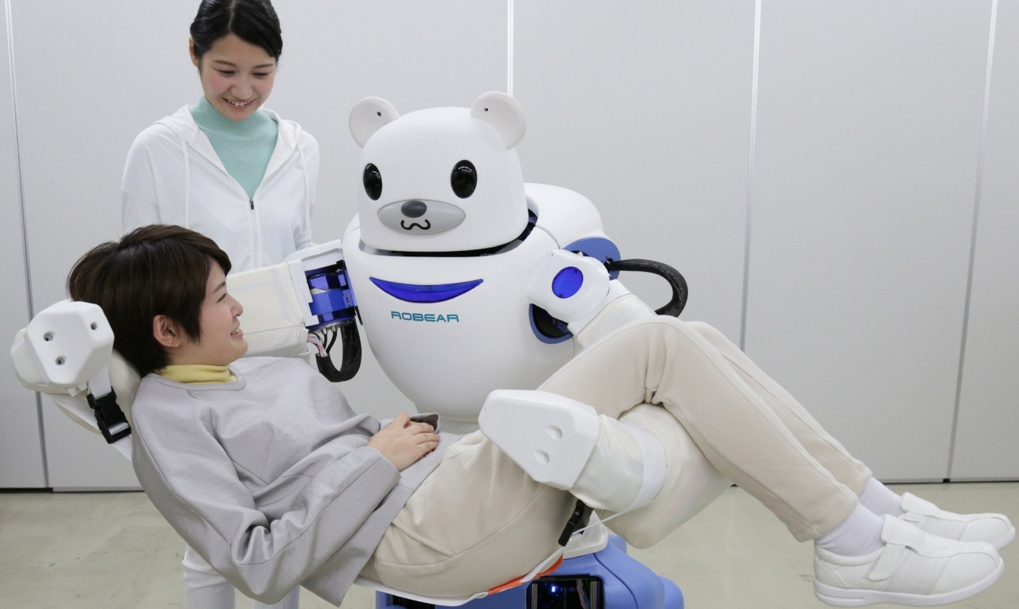

Slide 14

These robots are equipped with features to aid in walking, balance, and strength exercises, highlighting the integration of robotics in enhancing rehabilitation techniques and providing personalized support.

Slide 15

OpenEvidence

Slide 16
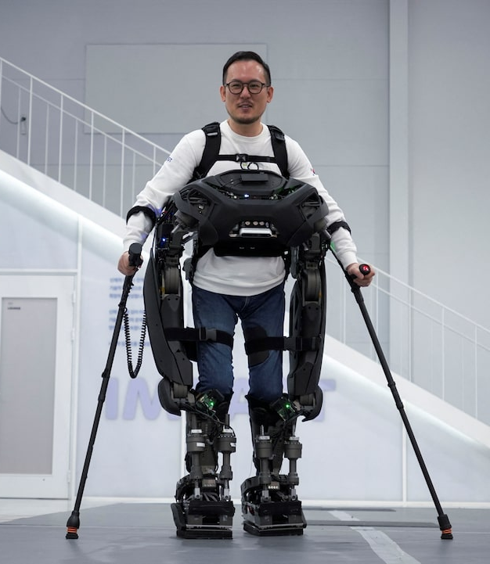
South Korean team develops ‘Iron Man’ robot that helps paraplegics walk
Korean (Reuters) researchers have developed a lightweight wearable robot that can walk up to paraplegic users and lock itself onto them, enabling them to walk, manoeuvre obstacles and climb staircases.
The Exoskeleton Laboratory team at the Korea Advanced Institute of Science and Technology (KAIST) said their goal is to create a robot that seamlessly integrates into the daily lives of individuals with disabilities.
https://www.reuters.com/technology/south-korean-team-develops-iron-man-robot-that-helps-paraplegics-walk-2024-12-23/

Slide 17

Video
https://www.youtube.com/watch?v=GO0YYp5xT4o

